Slide 1
Advanced Java
Inheritance, Polymorphism, Interfaces, Packages, and Exceptions
CS 3331

Slide 2
Inheritance
Inheritance is a Fundamental object-oriented technique. It is used to organize and create reusable classes
  deriving new classes from existing classes
  creating class hierarchies

Slide 3
Inheritance
Inheritance allows a software developer to derive a new class from an existing one
The existing class is called the parent class, or superclass, or base class
The derived class is called the child class or subclass.
As the name implies, the child inherits characteristics of the parent
That is, the child class inherits the methods and data defined for the parent class

Slide 4
Inheritance
To tailor a derived class, the programmer can add new variables or methods, or can modify the inherited ones
Software reuse is at the heart of inheritance
By using existing software components to create new ones, we capitalize on all the effort that went into the design, implementation, and testing of the existing software

Slide 5
Inheritance
Inheritance relationships often are shown graphically in a UML class diagram, with an arrow with an open arrowhead pointing to the parent class
Vehicle
Inheritance should create an is-a relationship, meaning the child is a more specific version of the parent
Car

Slide 6
Deriving Subclasses
In Java, we use the reserved word extends to establish an inheritance relationship
class Car extends Vehicle
{
// class contents
}

Slide 7
Encapsulation
Encapsulation is another fundamental OOP concept.
Encapsulation in Java is a mechanism of wrapping the data (variables) and code acting on the data (methods) together as a single unit.
In encapsulation, the variables of a class will be hidden from other classes, and can be accessed only through the methods of their current class.

Slide 8
Encapsulation
Encapsulation is also known as data hiding.
To achieve encapsulation in Java −
  Declare the variables of a class as private.
  Provide public setter and getter methods to modify and view the variables values.

Slide 9
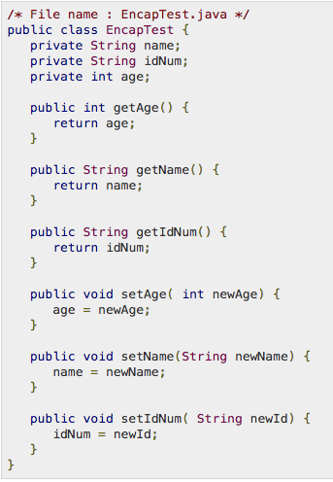
Encapsulation
Example
Variables are Private
Get and Set methods provide access.

Slide 10
The protected Modifier
Visibility modifiers determine which class members are inherited and which are not
Variables and methods declared with public visibility are inherited; those with private visibility are not
But public variables violate the principle of encapsulation
There is a third visibility modifier that helps in inheritance situations: protected

Slide 11
The protected Modifier
The protected modifier allows a member of a base class to be inherited into a child
Protected visibility provides more encapsulation than public visibility does
However, protected visibility is not as tightly encapsulated as private visibility
Protected variables and methods can be shown with a # symbol preceding them in UML diagrams

Slide 12

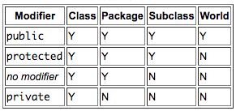
Java Access Levels

Slide 13
UML Diagram for Words
Book
# pages : int
+ pageMessage() : void
Words
Dictionary
- definitions : int
+ main (args : String[]) : void
+ definitionMessage() : void

Slide 14
The super Reference
Constructors are not inherited, even though they have public visibility
Yet we often want to use the parent's constructor to set up the "parent's part" of the object
The super reference can be used to refer to the parent class, and often is used to invoke the parent's constructor

Slide 15
The super Reference
A child’s constructor is responsible for calling the parent’s constructor
The first line of a child’s constructor should use the super reference to call the parent’s constructor
The super reference can also be used to reference other variables and methods defined in the parent’s class

Slide 16
Exercise
What will this code print?
/* Base class vehicle */
class Vehicle {
int maxSpeed = 120; }
/* sub class Car extending vehicle */
class Car extends Vehicle {
int maxSpeed = 180;
void display() {
/* print maxSpeed of base class (vehicle) */
System.out.println("Maximum Speed: " + super.maxSpeed);
} }
/* Driver program to test */
class Test {
public static void main(String[] args) {
Car small = new Car();
small.display(); } }

Slide 17
/* Base class Person */
class Person {
void message() {
System.out.println("This is person class"); } }
/* Subclass Student */
class Student extends Person {
void message() {
System.out.println("This is student class"); }
// Note that display() is only in Student class
void display() {
// will invoke or call current class message() method
message();
// will invoke or call parent class message() method
super.message(); } }
/* Driver program to test */
class Test {
public static void main(String args[]) {
Student s = new Student();
// calling display() of Student
s.display(); } }

Slide 18
Super() Examples
class Animal{
String color="white"; }
class Dog extends Animal{
String color="black";
void printColor(){
System.out.println(color);// color of Dog class
System.out.println(super.color);//color of Animal class } }
class TestSuper1{
public static void main(String args[]){
Dog d=new Dog();
d.printColor();
}}

Slide 19
Super() Examples
class Animal{
void eat(){System.out.println("eating...");} }
class Dog extends Animal{
void eat(){System.out.println("eating bread...");}
void bark(){System.out.println("barking...");}
void work(){
super.eat();
bark(); } }
class TestSuper2{
public static void main(String args[]){
Dog d=new Dog();
d.work();
}}

Slide 20
Super() Examples
class Animal{
Animal(){System.out.println("animal is created");}}
class Dog extends Animal{
Dog(){
super();
System.out.println("dog is created");
} }
class TestSuper3{
public static void main(String args[]){
Dog d=new Dog();
}}

Slide 21
Multiple Inheritance
Java supports single inheritance, meaning that a derived class can have only one parent class
Multiple inheritance allows a class to be derived from two or more classes, inheriting the members of all parents
Collisions, such as the same variable name in two parents, have to be resolved
Java does not support multiple inheritance

Slide 22
Overriding Methods
A child class can override the definition of an inherited method in favor of its own
The new method must have the same signature as the parent's method, but can have a different body

Slide 23
Overriding
A parent method can be invoked explicitly using the super reference
If a method is declared with the final modifier, it cannot be overridden

Slide 24
Overloading vs. Overriding
Don't confuse the concepts of overloading and overriding
Overloading deals with multiple methods with the same name in the same class, but with different signatures
Overriding deals with two methods, one in a parent class and one in a child class, that have the same signature
Overloading lets you define a similar operation in different ways for different data
Overriding lets you define a similar operation in different ways for different object types

Slide 25
Class Hierarchies
A child class of one parent can be the parent of another child, forming a class hierarchy
Business
RetailBusiness
ServiceBusiness
KMart
Macys
Kinkos

Slide 26
Class Hierarchies
Two children of the same parent are called siblings
Common features should be put as high in the hierarchy as is reasonable
An inherited member is passed continually down the line
Therefore, a child class inherits from all its ancestor classes
There is no single class hierarchy that is appropriate for all situations

Slide 27
The Object Class
A class called Object is defined in the java.lang package of the Java standard class library
All classes are derived from the Object class
If a class is not explicitly defined to be the child of an existing class, it is assumed to be the child of the Object class
Therefore, the Object class is the ultimate root of all class hierarchies

Slide 28
The Object Class
The Object class contains a few useful methods, which are inherited by all classes
For example, the toString method is defined in the Object class
Every time we have defined toString, we have actually been overriding an existing definition
The toString method in the Object class is defined to return a string that contains the name of the object’s class together along with some other information

Slide 29
The Object Class
All objects are guaranteed to have a toString method via inheritance
Thus the println method can call toString for any object that is passed to it

Slide 30
Abstract Classes
An abstract class is a placeholder in a class hierarchy that represents a generic concept
An abstract class cannot be instantiated
We use the modifier abstract on the class header to declare a class as abstract:
public abstract class Whatever
{
// contents
}

Slide 31
Abstract Classes
An abstract class often contains abstract methods with no definitions (like an interface does)
Unlike an interface, the abstract modifier must be applied to each abstract method
An abstract class typically contains non-abstract methods (with bodies), further distinguishing abstract classes from interfaces
A class declared as abstract does not need to contain abstract methods

Slide 32
Abstract Classes
The child of an abstract class must override the abstract methods of the parent, or it too will be considered abstract
An abstract method cannot be defined as final (because it must be overridden) or static (because it has no definition yet)
The use of abstract classes is a design decision – it helps us establish common elements in a class that is too general to instantiate

Slide 33
Java Static Variables
static keyword to create fields and methods that belong to the class, rather than to an instance of the class
Fields that have the static modifier in their declaration are called static fields or class variables

Slide 34
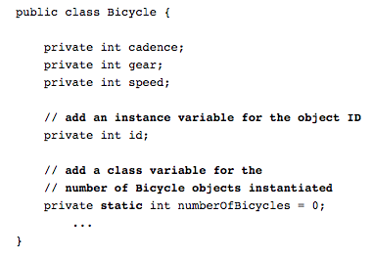
Java Static Example
numberOfBicycles will keep track of the number of Bicycle objects that have been created

Slide 35
Indirect Use of Members
An inherited member can be referenced directly by name in the child class, as if it were declared in the child class
But even if a method or variable is not inherited by a child, it can still be accessed indirectly through parent methods

Slide 36
References and Inheritance
An object reference can refer to an object of its class, or to an object of any class related to it by inheritance
For example, if the Holiday class is used to derive a child class called Christmas, then a Holiday reference could be used to point to a Christmas object
Holiday day;
day = new Christmas();

Slide 37
References and Inheritance
Assigning a predecessor object to an ancestor reference is considered to be a widening conversion, and can be performed by simple assignment
Assigning an ancestor object to a predecessor reference can be done also, but it is considered to be a narrowing conversion and must be done with a cast
The widening conversion is the most useful

Slide 38
Polymorphism via Inheritance
It is the type of the object being referenced, not the reference type, that determines which method is invoked
Suppose the Holiday class has a method called celebrate, and the Christmas class overrides it
Now consider the following invocation:
day.celebrate();
If day refers to a Holiday object, it invokes the Holiday version of celebrate; if it refers to a Christmas object, it invokes the Christmas version
Holiday
Christmas

Slide 39
Interfaces
Declare features to be supported by classes
Provide no implementation
Good for establishing a well-defined boundary between modules (subsystems)
Thus, make programs more reusable and maintainable
public interface ActionListener
{
void actionPerformed(ActionEvent event);
}

Slide 40
Implementing Interfaces
When a class implements an interface, you can think of the class as signing a contract, agreeing to perform the specific behaviors of the interface.
A class uses the implements keyword to implement an interface. The implements keyword appears in the class declaration following the extends portion of the declaration.

Slide 41
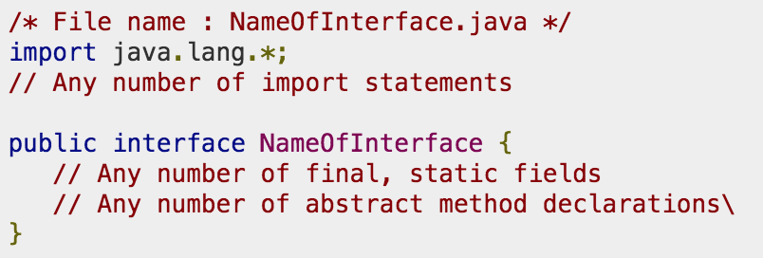
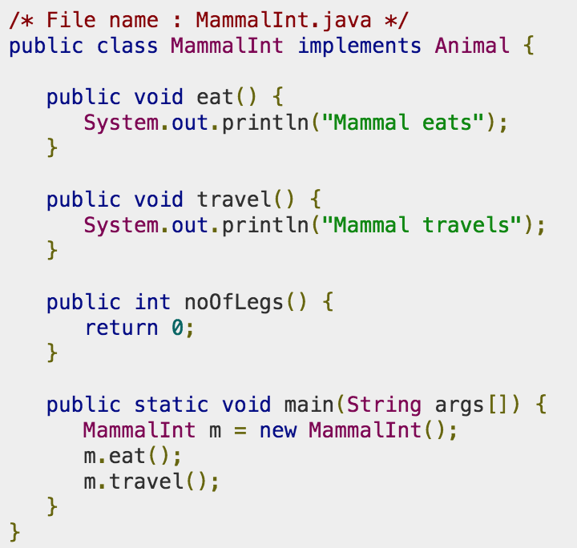
Example

Slide 42
Interface Hierarchies
Inheritance can be applied to interfaces as well as classes
One interface can be derived from another interface
The child interface inherits all abstract methods of the parent
A class implementing the child interface must define all methods from both the ancestor and child interfaces
All members of an interface are public

Slide 43
Inheritance and GUIs
An applet is an excellent example of inheritance
Recall that when we define an applet, we extend the Applet class or the JApplet class
The Applet and JApplet classes already handle all the details about applet creation and execution, including:
  interaction with a Web browser
  accepting applet parameters through HTML
  enforcing security restrictions

Slide 44
Inheritance and GUIs
Our applet classes only have to deal with issues that specifically relate to what our particular applet will do

Slide 45
Features of Java (2)
Packages and Exceptions
Sections 4.5 and 4.6

Slide 46
Outline
Package
Exception

Slide 47
Organizing Java Programs
Java provides mechanisms to organize large-scale programs in logical and maintainable fashion.
  Class: highly cohesive functionalities; unit of encapsulation.
  File: one or more closely related classes; unit of compilation.
  Package: a collection of related classes or packages.

Slide 48
Package Declaration
Use package statements to declare package for classes and interfaces, e.g.,
    // File: Homework1.java
    package cs3331;
    public class Homework1 { /* … */ }
    // File: MyProject.java
    package cs3331.proj1;
    public interface MyProject { /* … */ }
  The package statement must be the first statement.
  Q: What if the package statement is missing?

Slide 49
Package Declaration (Cont.)
Use all lowercase letters for package names
Use reverse domain names if plan to publish widely, e.g.,
package edu.utep.cs.cs3331;

Slide 50
Example - JDK Packages
JDK library classes are organized into a number of packages:
  java.awt: GUI
  java.io: I/O
  java.util: utilities
  java.applet: applet
  java.net: networking
  javax.swing: GUI
  The package java is reserved for JFC.

Slide 51
Referring to Classes from Other Packages
Use fully qualified names, e.g.,
public class MyApplet extends java.applet.Applet {
private java.util.List figures
= new java.util.LinkedList();
// …
}
Q: Why figures’s type List rather than LinkedList?

Slide 52
Referring to Classes (Cont.)
Use import statements, e.g.,
  import java.applet.Applet;
  import java.util.*;
public class MyApplet extends Applet {
private List figures = new LinkedList();
// …
}
  Q: Multiple import statements? JDK packages first and user-defined in the alphabetical order.

Slide 53
Avoiding Conflicts
What if two packages contain classes with the same name? What will happen?
// both java.awt and java.util have List
  import java.awt.*;
  import java.util.*;
  public class MyList extends List { /* … */}
Q: Why such a conflict can happen?

Slide 54
Avoiding Conflicts (Cont.)
Use fully qualified names, or
Import specific class to have a precedence, e.g.,
  import java.awt.List;
import java.awt.*;
  import java.util.*;
  public class MyList extends List { /* … */ }

Slide 55
How Are Packages Located?
Packages are mapped to directories, e.g.
// Suppose classes proj1.part1.A and proj2.B.
  public class Test {
  proj1.part1.A x;
  proj2.B y;
  }
Java tools (e.g., javac and java) try to find A in the directory ./proj1/part1 and B from ./proj2 (assuming that . is in CLASSPATH).

Slide 56
Outline
Package
Exception

Slide 57
Exceptions
An exception is an unexpected condition in programs, e.g., division by zero, null pointer, array index out of bound, etc.
A mechanism to recover from unexpected conditions or failures (i.e., exceptions) is called an exception handling mechanism.

Slide 58
Why Exception Handling?
Location difference
Separate flows of control for normal and exceptional
  public Object pop() throws StackEmptyException {
  if (isEmpty()) {
  throw new StackEmptyException();
  }
  // pop and return the top element of this stack...
  }

Slide 59
Exception Handling (Cont.)
  // Client code
  Stack jobStack = new Stack();
  // …
  try {
  Job work = (Job) jobStack.pop();
  // normal flow of control, e.g.,
  work.doIt();
  } catch (StackEmptyException e) {
  // exceptional flow of control …
  e.printStackTrace();
  }
normal flow
exceptional flow

Slide 60
Exception Hierarchy
  Exceptions are modeled as objects of exception classes.
  Exception classes are organized in a class hierarchy, called an exception hierarchy.
Unchecked
Exception
Throwable
Checked
Exception
Error
Exception
JVM
errors
RuntimeException
JVM
exceptions
user
exceptions
JVM
exceptions

Slide 61
Unchecked vs. Checked
Unchecked exceptions
  Exceptions that need not be handled or recovered
  Errors and runtime exceptions
Checked exceptions
  Exceptions that need be addressed, i.e., caught or declared in the throws clause
  All others except for errors and runtime exceptions

Slide 62
Example - Unchecked
public void doSomething(Object x) {
String str = x.toString(); // NullPointerException
// …
}

Slide 63
Example - Checked
// Incorrect code
public void readFile(String n) {
// can throw java.io.FileNotFoundException
FileInputStream f = new FileInputStream(n);
// …
}
// Correct code: propagate exceptions
public void readFile(String n) throws java.io.FileNotFoundException {
FileInputStream f = new FileInputStream(n);
// …
}

Slide 64
Example - Checked (Cont.)
// Correct code: catch and handle exceptions
public void readFile(String n) {
try {
FileOutputStream f = new FileOutputStream(n);
// …
} catch (FileNotFoundException e) {
e.printStackTrace();
System.exit(-1);
}
}

Slide 65
Defining Your Own Exceptions
Same as defining regular classes
public class StackEmptyException extends Exception {
public StackEmptyException() {
}
public StackEmptyException(String msg) {
super(msg);
}
// other fields and methods here …
}

Slide 66
Throwing Exceptions
Use the throw statement
public class Stack {
/** Pops and returns the top element of this stack. */
public Object pop() throws StackEmptyException {
if (isEmpty()) {
throw new StackEmptyException(“Sorry, stack is empty.”);
}
// the rest of code …
}
// other fields and methods here …
}
Q: Why need the throws clause?

Slide 67
Handling Exceptions
Use the try-catch-[finally] statement
  Stack jobs = …;
  try {
  // normal case …
  Job work = (Job) jobs.pop();
  work.doIt();
  } catch (StackEmptyException e) {
  // handle exceptions
  fireMe();
  } finally {
  // finalization
  goVacation();
  }
  Can have multiple catch clauses.

Slide 68
Exercise
What is wrong with the definition of the class YourClass. Fix it.
java.lang.Exception
public class YourClass {
public void doYourJob(int x) {
new MyClass().doMyJob(x);
}
}
MyException
MyClass
doMyJob()
public void doMyJob(int x)
throws IllegalArgumentException,
MyException {
// …
}

